Slide 1



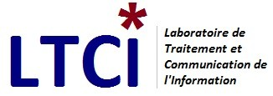


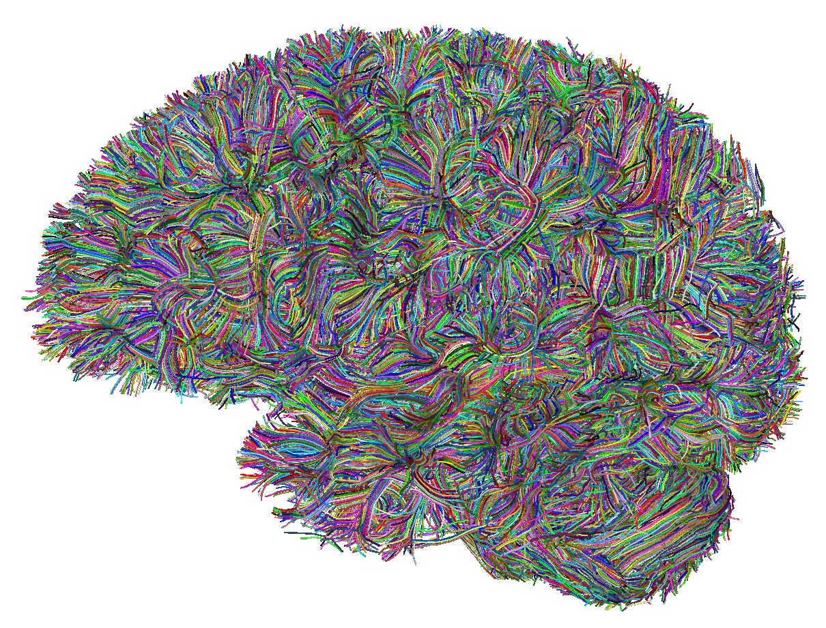
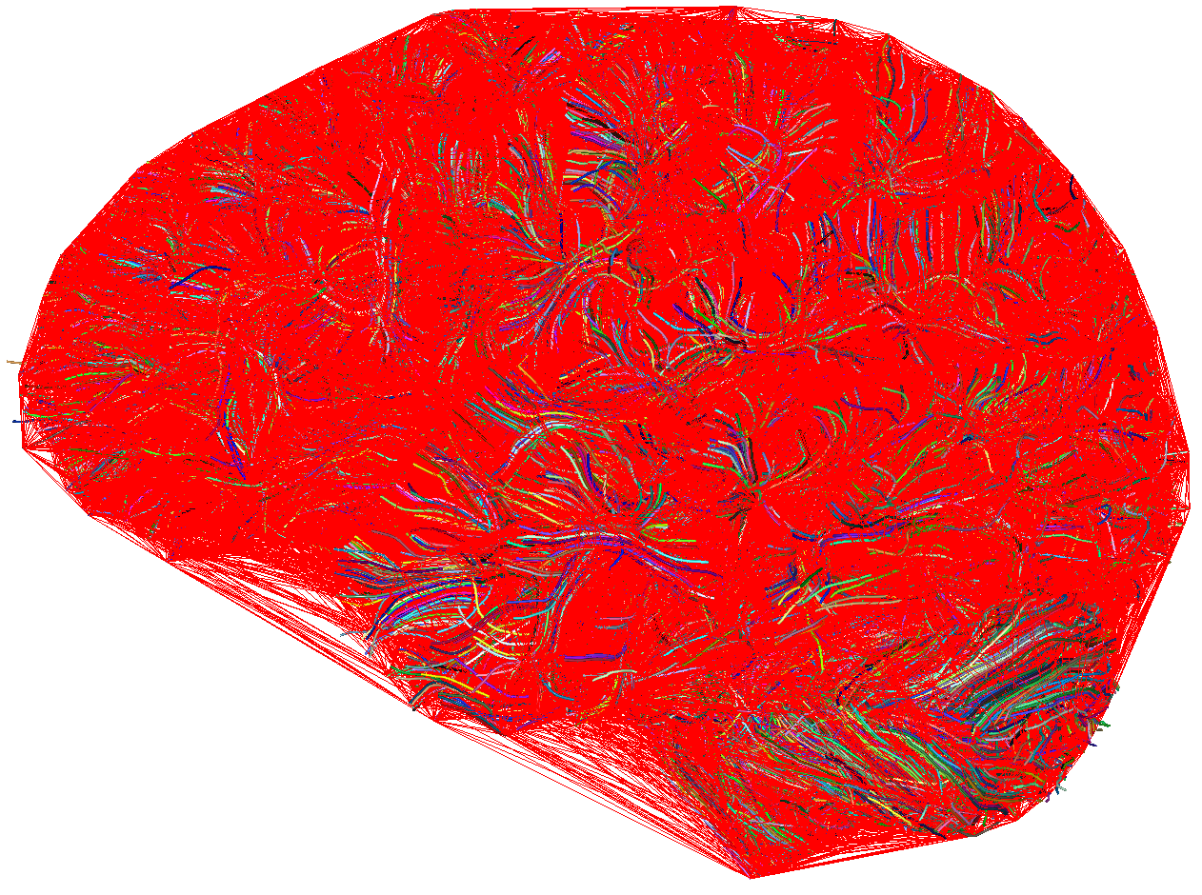
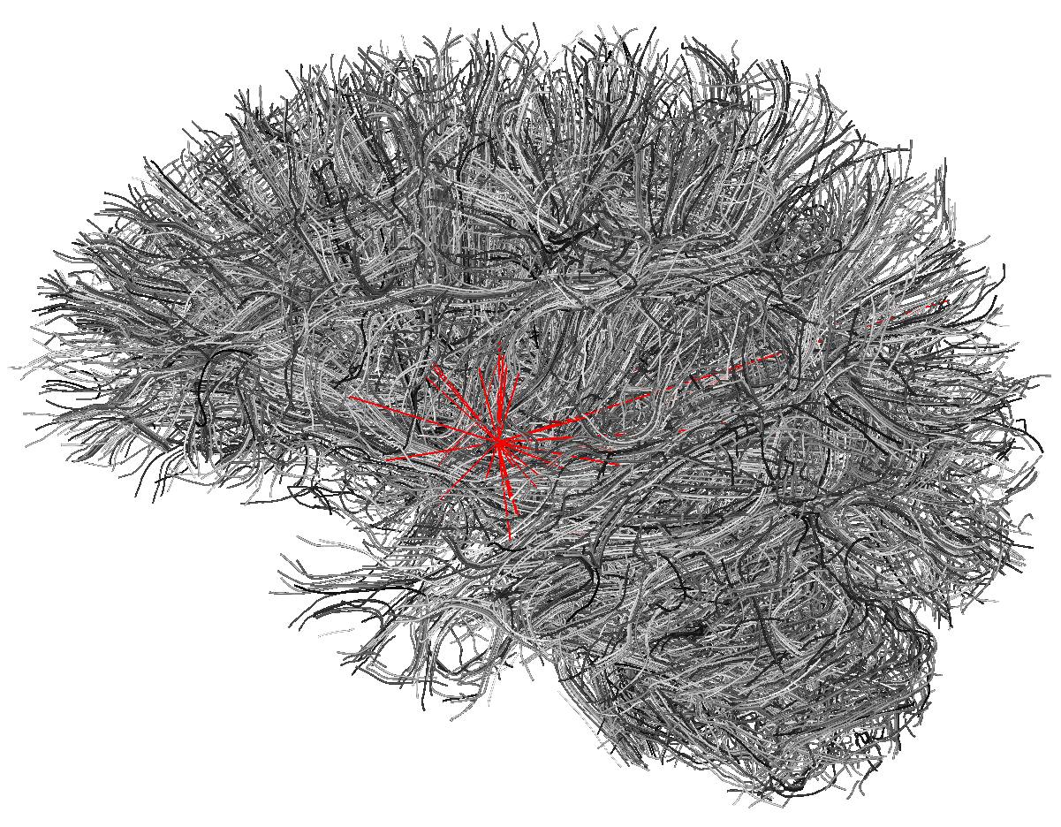
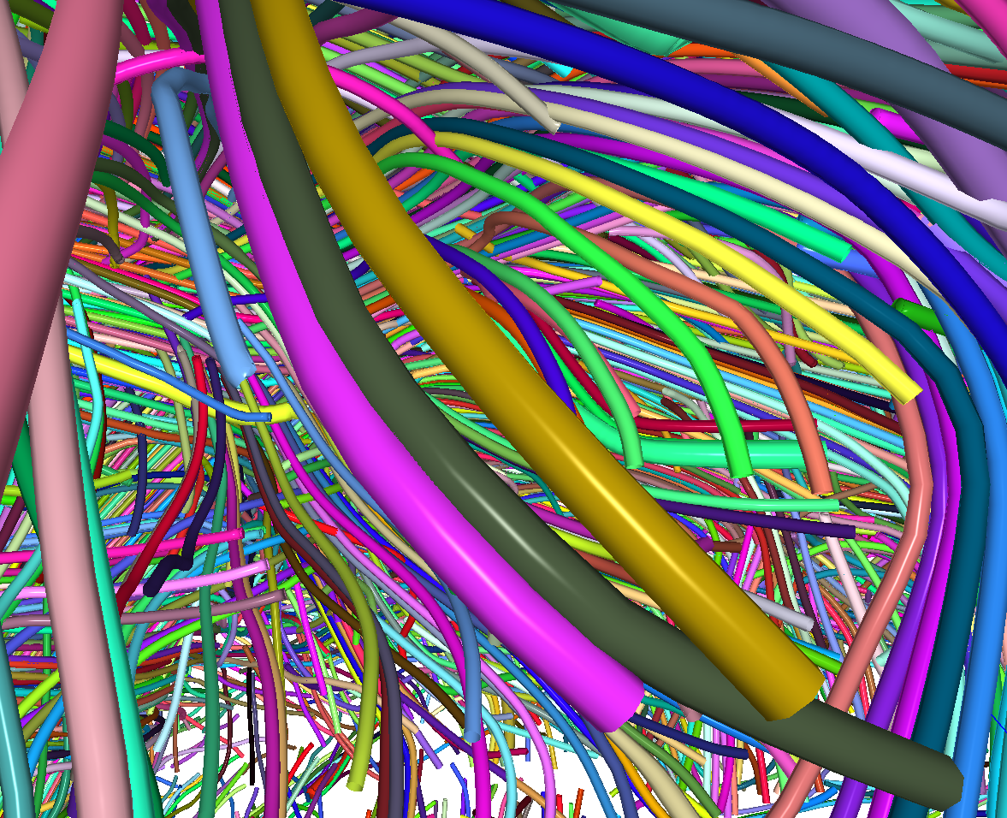
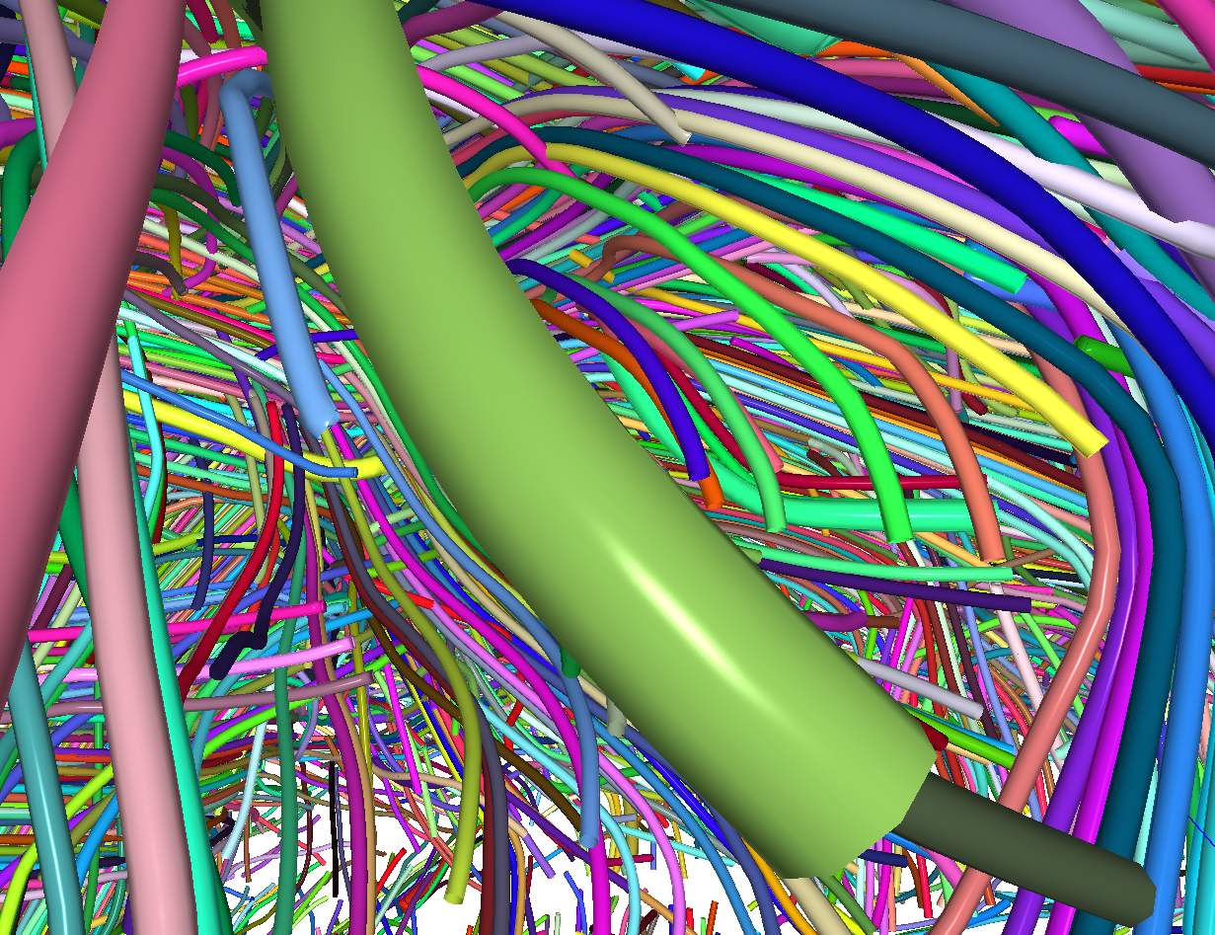
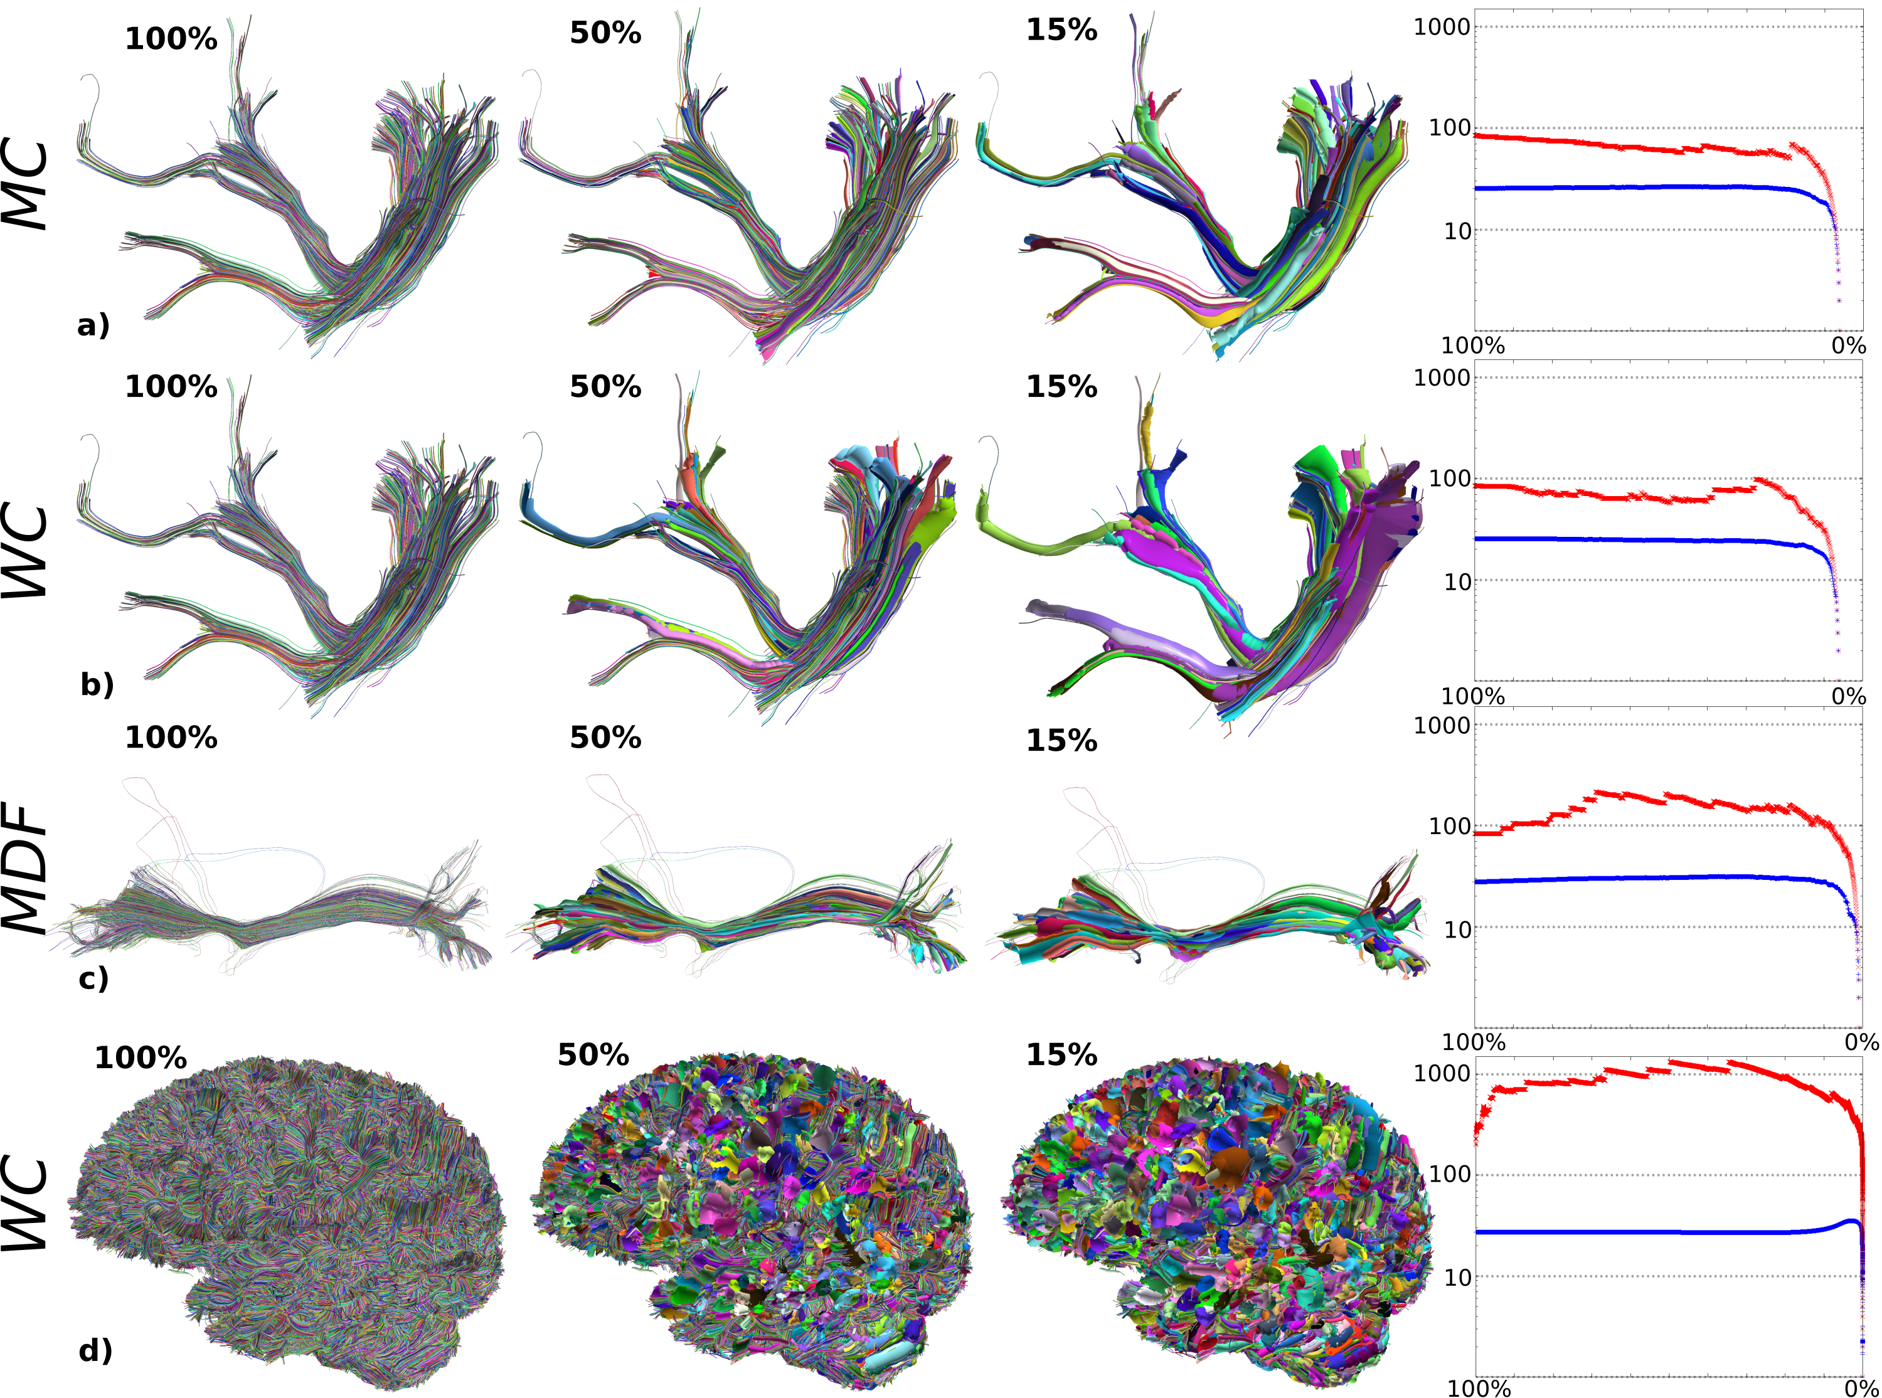
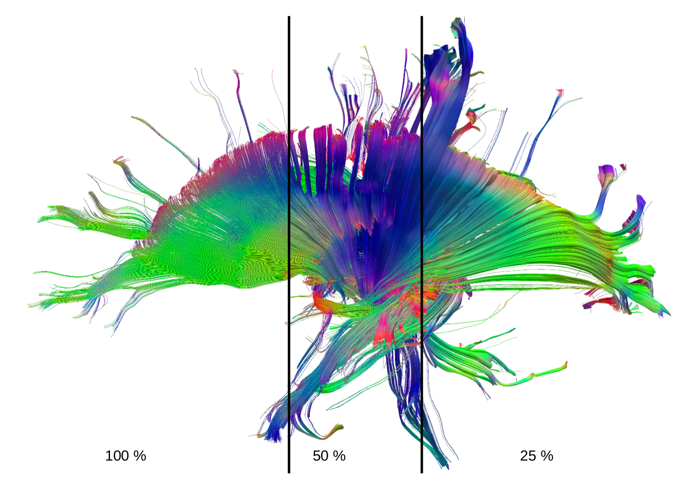
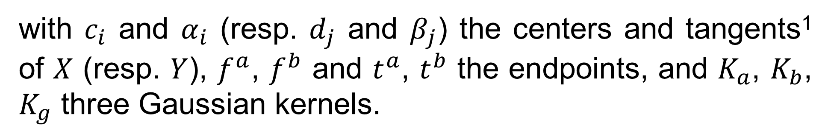
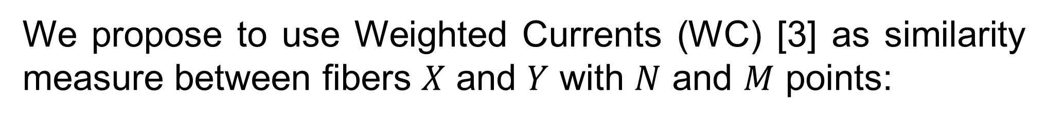
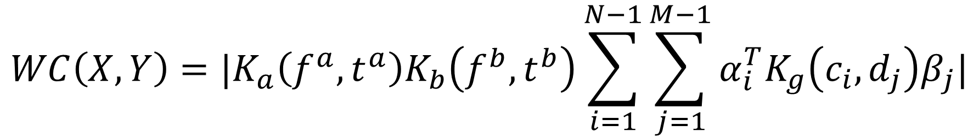
Neural Meta Tracts: Progressive and Efficient Multi-Resolution Representations for Brain Tractograms
PhD Student
Supervisors
Corentin MERCIER
Introduction
Pietro GORI
Damien ROHMER
Marie-Paule CANI
Tamy BOUBEKEUR
Jean-Marc THIERY
Isabelle BLOCH
Current tractography methods generate tractograms composed of millions of 3D polylines called fibers, making visualization, interpretation and processing extremely challenging.
As a result, they are difficult to use in a clinical environment (e.g. surgery planning, prognosis, interpretation).
We propose to progressively simplify tractograms by grouping similar fibers into a specific geometric representation, taking inspiration from computer graphics methods [2].
Method [1]
1)
Tetrahedralization based on fibers extremities
To improve computational time and memory of the following metric computation, we find neighboring fibers as the result of a tetrahedralization on all fibers endpoints.
An average of 25 neighbors per fiber is found using this method.
Full Brain (1M fibers)
We propose to use Weighted Currents (WC) [3] as similarity measure between fibers $X$ and $Y$ with $N$ and $M$ points:
2)
Metric Computation
A similarity/distance is computed between all neighboring fibers.
$$WC\left(X, Y\right)=|K_{a}\left(f^{a}, t^{a}\right)K_{b}\left(f^{b}, t^{b}\right)\sum_{i=1}^{N−1}{\sum_{j=1}^{M−1}{α_{i}^{T}K_{g}\left(c_{i},d_{j}\right)β_{j}|}}$$
with $c_{i}$ and $α_{i}$ (resp. $d_{j}$ and $β_{j}$) the centers and tangents¹ of $X$ (resp. $Y$), $f^{a}$, $f^{b}$ and $t^{a}$, $t^{b}$ the endpoints, and $K_{a}$, $K_{b}$, $K_{g}$ three Gaussian kernels.
¹computed from two successive points along a fiber
The most similar fibers are progressivly merged by pairs into generalized cylinders. This allows for L-1 levels of resolution (L being the total number of fibers).
3)
Progressive merges
Results
Real-time visualization with interactively defined level of details.
Overall structure preserved even at low resolutions.
O(n log(n)) complexity.
The graphs represent the valence of the fibers with respect to the resolution. The maximum valence is in red, and the average valence is in blue. The stability of the average valence means that the measure favors geome-trically well distributed cy-linders.
Perspectives
LTCI research day
Geometry based on implicit surfaces
Metric using additional information and better suited to our algorithm
Better visualization using for instance ambiant occlusion
Improvement of the navigation in the tractogram
Improvement of the user interface
11th October 2018
References
[1] Mercier, C., Gori, P., et al.: Progressive and Efficient Multi-Resolution Representations for Brain Tractograms, EG VCBM, 2018.
[2] Hoppe, H., DeRose, T., et al.: Mesh optimization, ACM SIGGRAPH, 1993.
[3] Gori, P., Colliot, O., et al.: A Prototype Representation to Approximate White Matter Bundles with Weighted Currents, MICCAI 2014.
Contact
corentin.mercier@telecom-paristech.fr
Website
﻿https://perso.telecom-paristech.fr/comercier/

